Slide 1
NOBEL WEIGHING SYSTEMS
Solutions for Crane Weighing
Notes:
Presentation of Nobel Weighing Systems a part of VPG

Slide 2
Advantages of Nobel Crane Weighing
Custom designed load cell makes solution easy to implement
Multiple load cell applications can be managed by one instrument.
Instrument provides “level supervision” of all load cells for intelligent weighing
Specially developed software for crane weighing
  Setup & Display functions for Crane applications
  Life Cycle datalogger automatically calculates “working life” of crane
  Mean value measurement for accurate weighing under dynamic loading

Slide 3
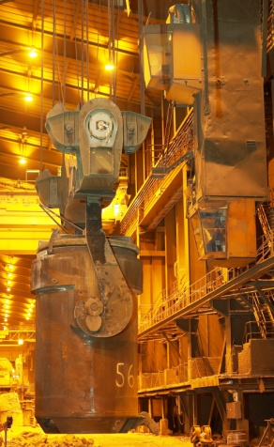
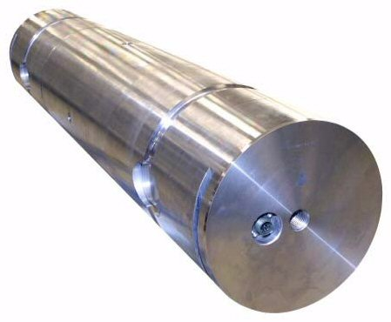
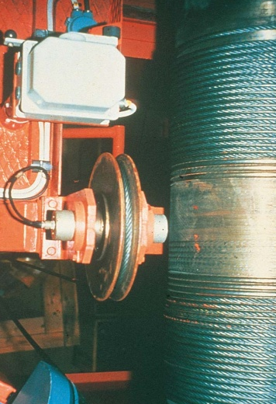
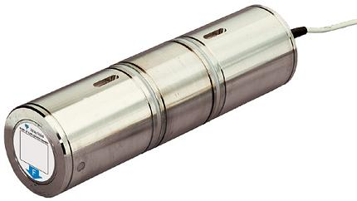
Crane Weighing
Weighing (process, inventory control)
Overload Control
Load imbalance
Life Cycle (optimize service & maintenance intervals)
Accurate Crane weighing with custom made load cells located in
  Lower Block
  Upper Block – Equalizing Sheave

Slide 4
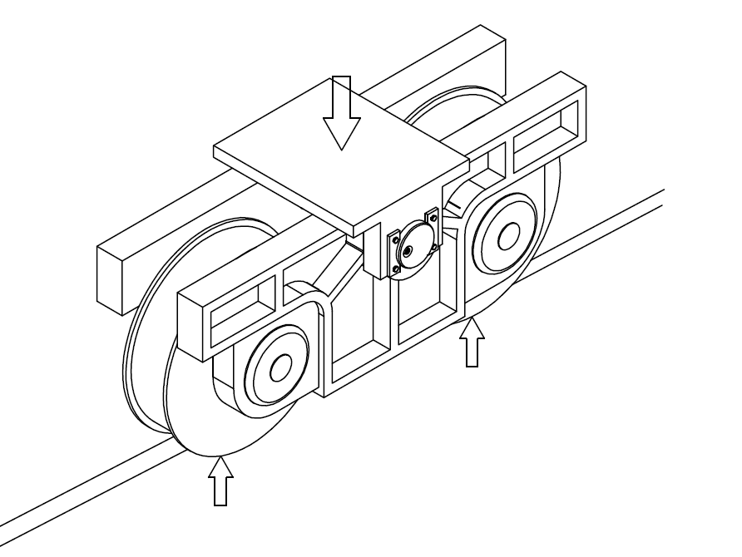
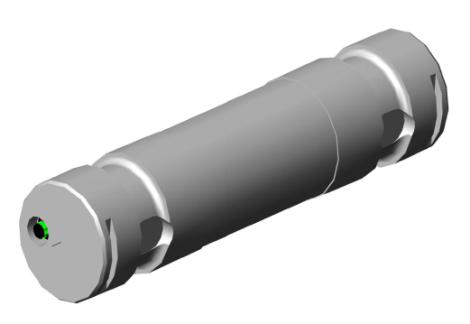
Crane weighing application
KIMD load cells in crane trolley weighing entire bridge crane

Slide 5
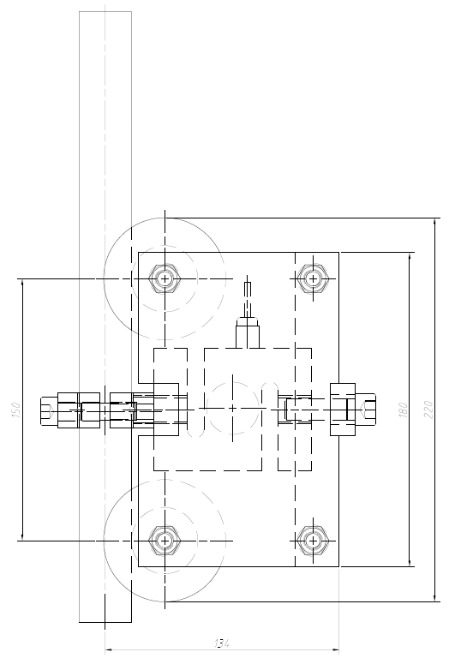
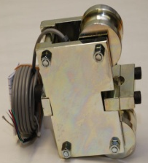
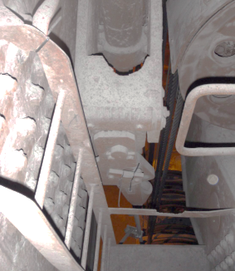
Overload application
Less Accurate Crane weighing with rope tension transducer
RTT
Rope Tension Transducer, “clamp on wire” when load cells can’t be installed.
Accuracy 2 % R.O., Repeatability 1% R.O
Wires up to 1-1/2 in (36 mm) diameter
Dead weight calibration necessary

Slide 6
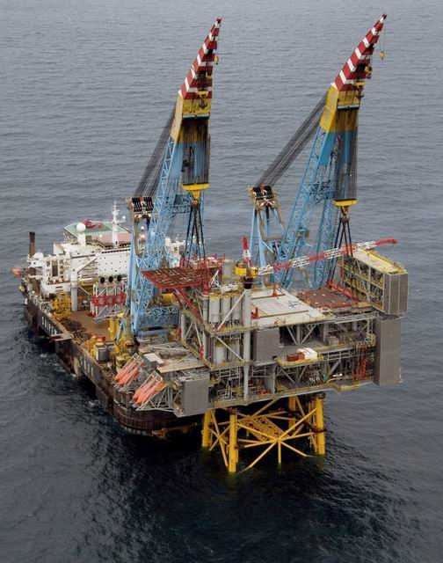

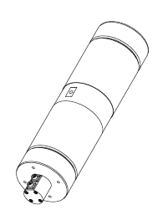
Load Cells for Offshore Cranes
Specifications
200kN to 2 MN (45k to 450k LB)
Built-in transmitter 4-20 mA
Dual bridge and transmitters
Hazardous location approval
Accuracy of load cell
  0,1 to 1% (customer demand)
Load Cells used
  KOSD
  KIMD
  KISD
Applications
  Weighing
  Overload

Slide 7
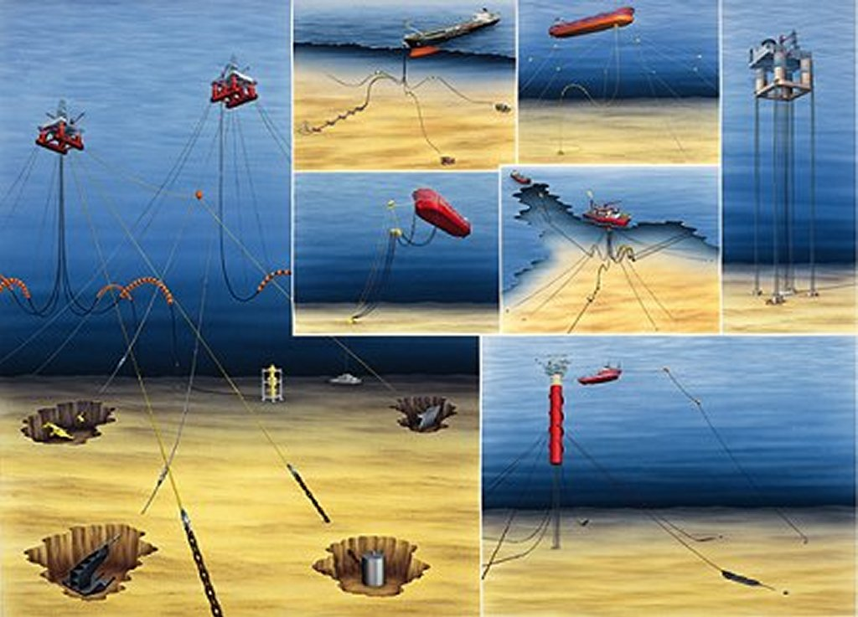
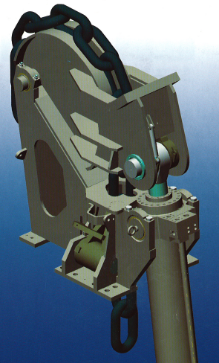
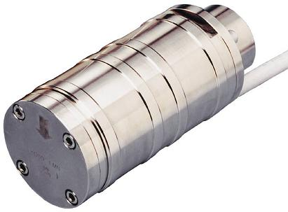
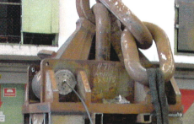
Mooring and Chain Stoppers
Specifications
4-12 MN (450k to 2700k LB)
Built-in transmitter 4-20 mA
Dual bridge and transmitters
Hazardous location approval
On deck or submerged
  Material
  IP Class
Accuracy of load cell
  < 1% (customer demand)
Load Cells used
  KOSD

Slide 8
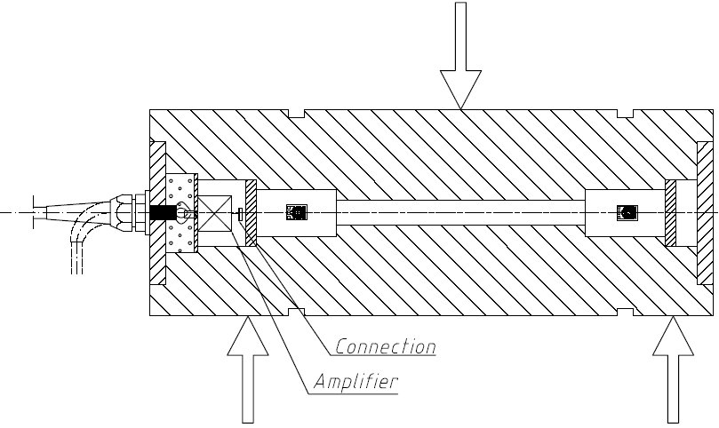
Transmitter for Offshore Applications
Features
Analog output 4-20 mA
Supply voltage ±10-30 VDC
Hazardous location approval
IP 68 and IP69K (Submerged)

Slide 9
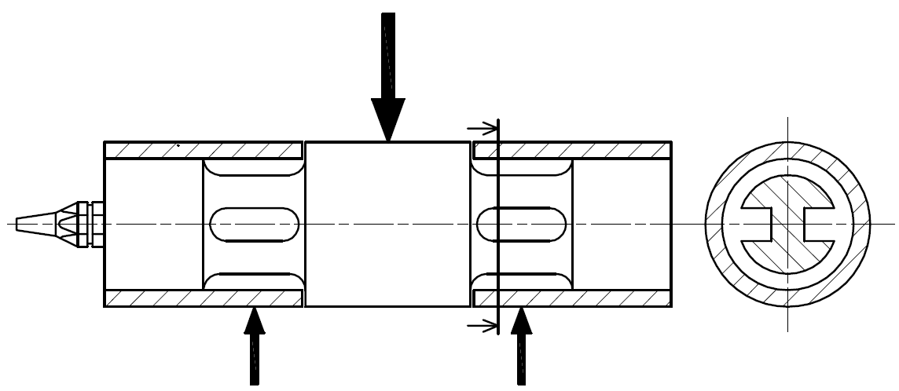
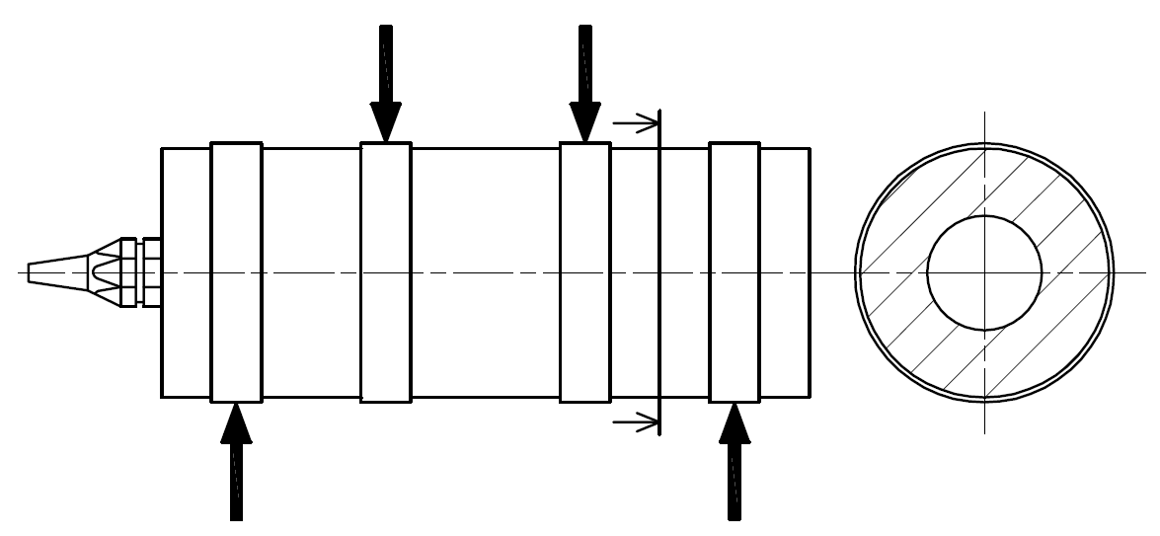
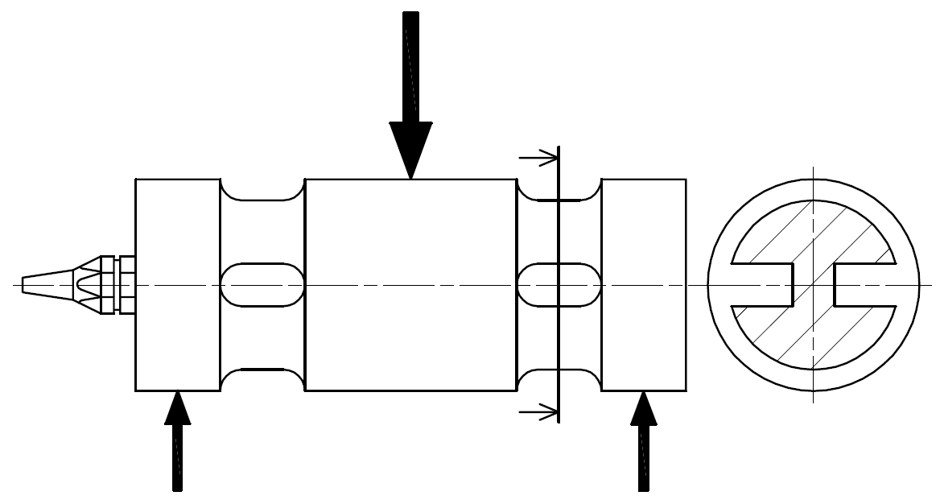
Load Cell models
KISD-type
KOSD-type
KIMD-type

Slide 10
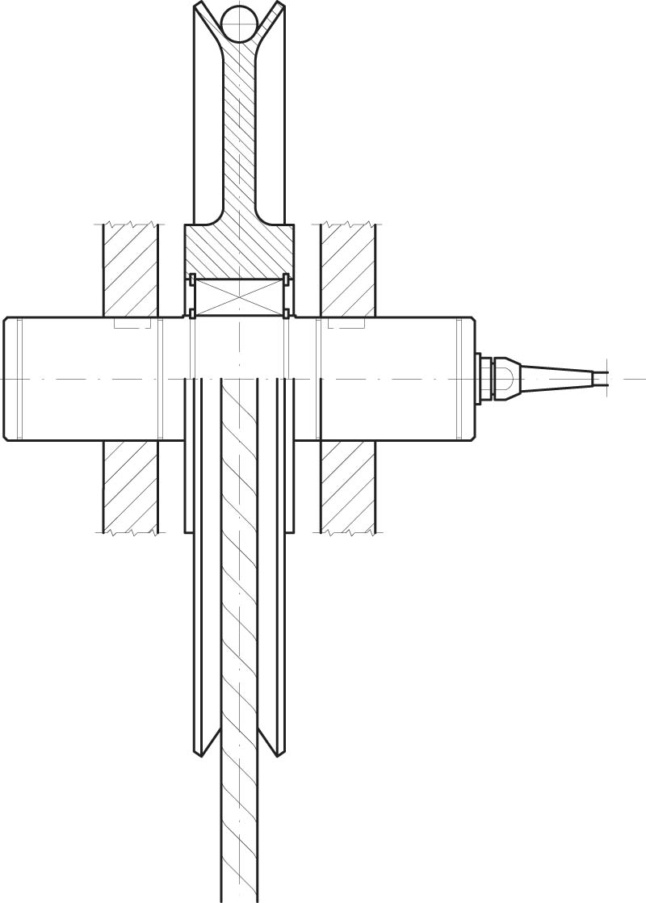
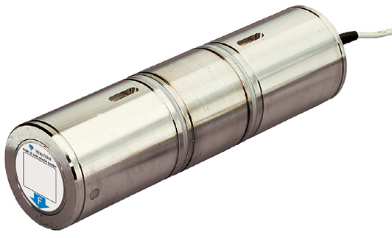
KISD-6
Highest accuracy 0,1%
50, 100, 200, 400, 1000 kN
(11k, 22k, 45k, 90k, 225k lbs)

Slide 11
KIMD
Medium accuracy 0,25%
500, 800 kN
(112k, 180k lbs)

Slide 12
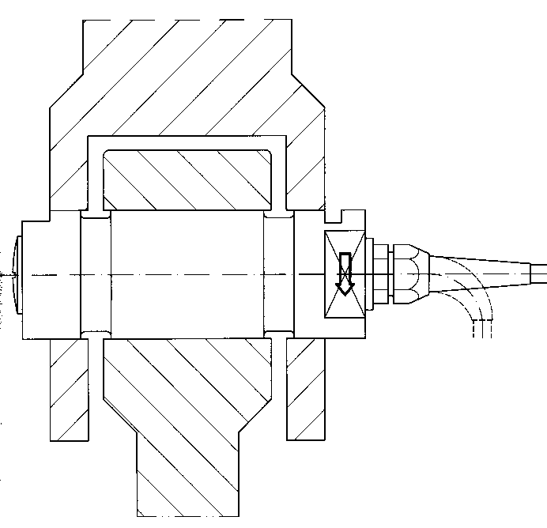
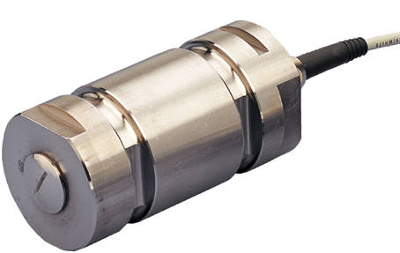
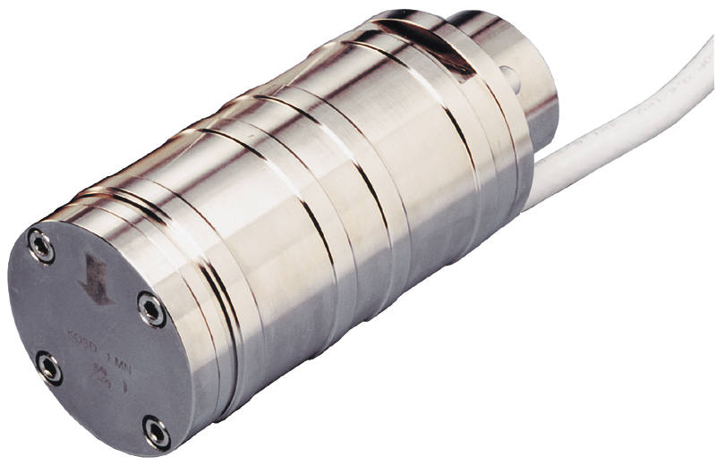
KOSD-40, -101, -107, -115
Less accurate (0,5 to 1%) than KISD/KIMD but is lower cost
KOSD-40
  10,20, 50, 100, 200 500 kN
  (2.25k, 4.5k, 11k, 22k 112k lbs.)
KOSD-101, 107
1000 kN (225k lbs)
KOSD-115
2000 kN (450k lbs)

Slide 13
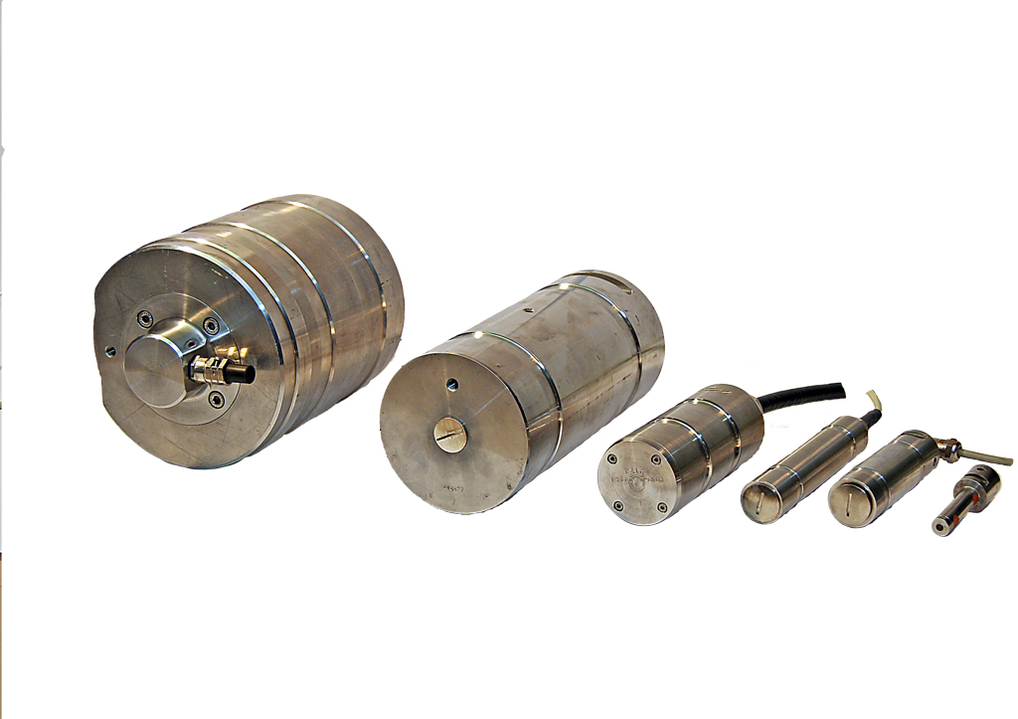
Custom Load Cells
Large and Small load cells:
Capacities 100 lb – 660 ton
Diameter ½ in – 15 in
Length 2 in – 80 in
KISD, KIMD, KOSD

Slide 14
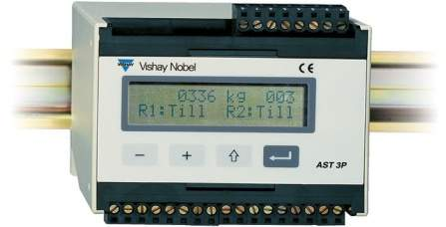
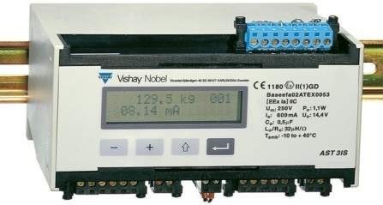
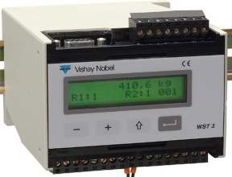
Generation 3 Instruments
Features
8,300,000 Count Total Resolution
Dynamic Digital Filtering
High speed analog output (300 updates/second)
Modbus RTU protocol
Profibus DP available WST 3
Hazardous locations AST 3IS
+/- 10 VDC, 0-20 or 4-20 mA Isolated Analog output
Relay output standard
Data sheet (electronic) or dead weight Calibration
PC software (deltaCOM) for setup & configuration
AST 3P/3B
AST 3IS
WST 3

Slide 15
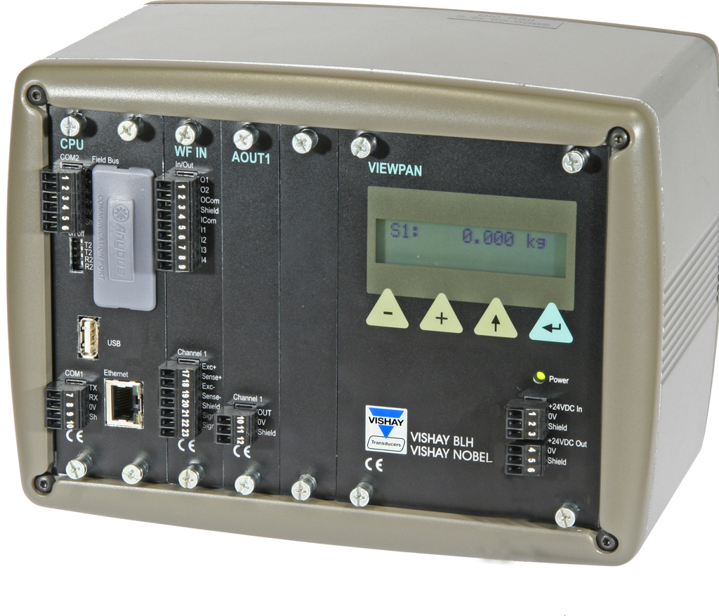
Generation 4 Instruments
Features
Multi-channel (synchronous measurement)
Modular hardware design (flexible and configurable)
High speed input (800 updates/second)
Flexible measurement output via FUNCTION BLOCKS
Software upgrades easily downloaded
Remote diagnostics and monitoring (web interface)
Custom Application software easily developed
G4 Panel Mount
G4 Rail Mount

